Slide 1
Project and energy services

Slide 2
New factory logistics
Duration
8 months on average per project. Two projects running concurrently for a period of 4 months.
Number of Projects
Three projects in South Asia
One project in United States
One project in India
Volumes (Per project)
600 ocean containers approx.
20’, 40’ HC, reefers, open tops
150 flat racks approx.
Breakbulk ocean shipments
Air charters (747-400’s)
Dry vans, flat-beds, step decks for legal and over dimensional shipments to POD
Scope of Services Rendered (Origin)
Local coordination and pickup from 60+ suppliers in 10+ different countries
Cargo Surveyors at port of export for breakbulk equipment
Over dimensional permits for inland transportation in Europe
Consolidation program in US
Ocean FCL as preferred MOT
Meetings with suppliers
Door to Port transportation via East and West Coast for US
Hazardous material movements

Slide 3
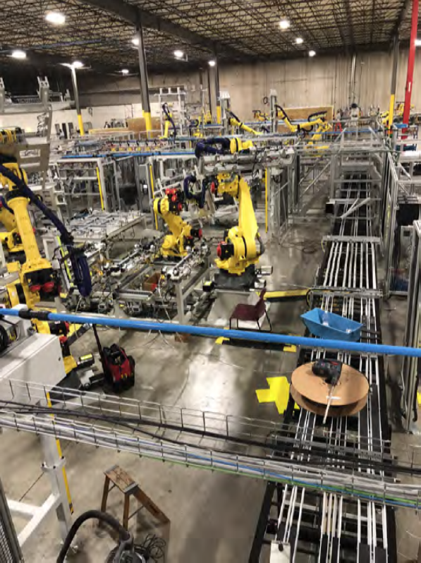
Scope of Services Rendered (Destination)
Control Tower
Expediting of pickups based off of required installation dates.
Route surveys
Kick off meetings
Customs clearance for 1 of the projects.
Local coordination for deliveries to remote locations for standard and OOG freight (PM deliveries only)
On site personnel
Weekly internal operational call
Weekly external operational call
Expeditors Team (varies by project)
1 Control Tower owner at each destination + 1 backup
1 Solar Project Manager based in Houston, TX.
1 Regional Project Cargo Managers supporting destination based in Singapore
3 Regional Project Cargo Managers supporting North America, Europe and Asia
3 Regional Account Managers
1 Regional Transition and Implementation (T&I) manager based in Detroit, MI

Slide 4
factory builds
Tera projects
TERA 0 | United States
Project duration: 4 months
50 x OOG flat racks, 150 x 40’ HC
TERA 1 | Malaysia
Project duration: 5 months
200 x OOG flat racks, 750 x 40’ HC
TERA 2 | Vietnam
Project duration: 5 months
200 x OOG flat racks, 750 x 40’ HC
TERA 3 | Vietnam
Project duration: 6 months
300 x OOG flat racks, 750 x 40’ HC
TERA 4 | United States
Project duration: 6 months
140 x OOG flat racks, 520 x 40’ HC x 42 x 20’ std, 40 x 40-’ reefer, 107 x domestic flatbeds
TERA 5 | Malaysia
Project duration: 6 months
160 x OOG flat racks, 620 x 40’ HC , 46 x 40’ reefers, 24 x 20’ std, 122 X domestic Flatbeds
TERA 7 | India
Project duration: 6 months
70 x OOG flat racks, 50 x flat racks in gauge, 115 x reefers, 15 x 20’ std, 200 x 40’ HC

